Slide 1




Team Gamed Gamod
Welcome to
CAR DEALER

Slide 2
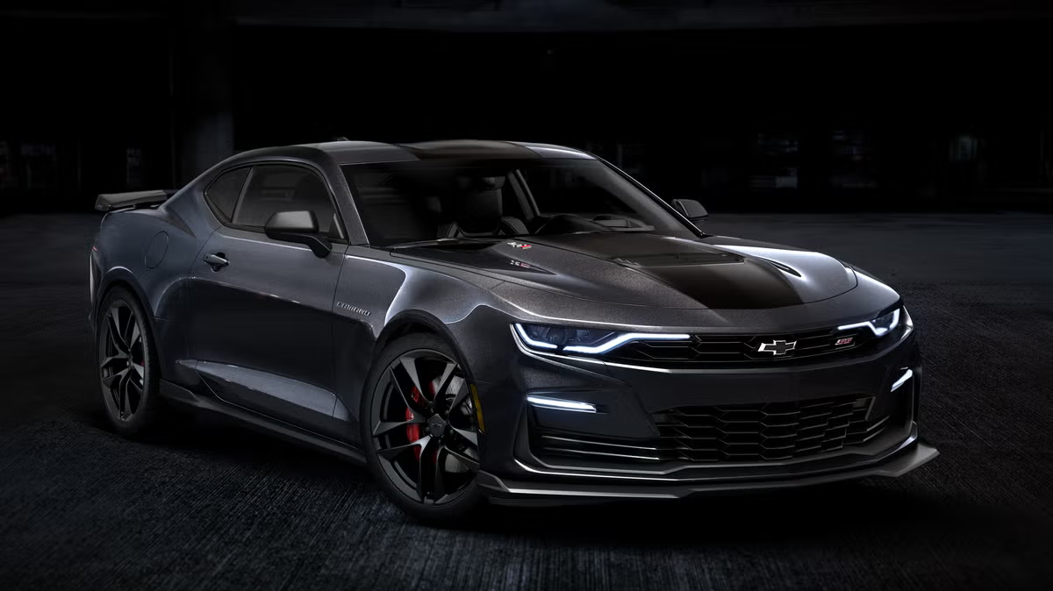
Page 02 of 10
Project Objective
The dashboard aims to deliver insights into sales performance, customer preferences, and regional sales distribution, helping business decision-makers and analysts understand key factors affecting car sales.

Slide 3
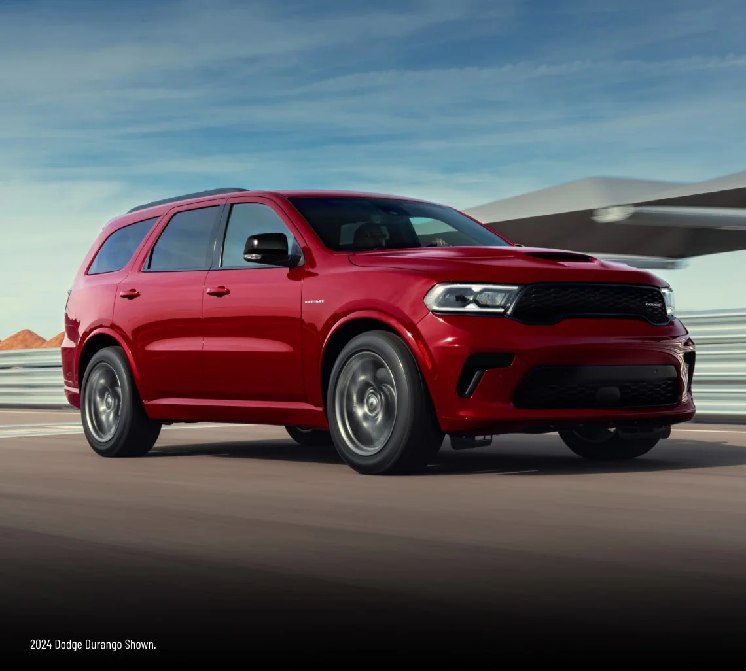
Page 03 of 10
Data Overview
The dataset contains 23,906 car sales records spanning from January 2022 to December 2023.
Key fields include Date, Gender, Annual Income, Dealer Name, Company, Model, Engine, Transmission, Color, Price, Body Style, and Dealer Region.
The data covers 30 unique companies and 154 unique car models, with a total sales value of approximately $ 672 million and 24,000 cars sold.
The dataset also categorizes cars by transmission type, body style, and color, allowing multi-dimensional analysis.

Slide 4

متنساش ديزني مقاطعة
Page 04 of 10
Data Preprocessing
Checked and formatted date fields to enable time-series analysis.
Categorized price into meaningful groups (Affordable, Mid-Range, Premium).
Ensured consistent labeling of categorical variables (e.g., Gender, Transmission).
Verified unique values and distribution for fields like Dealer Region, Body Style, and Car Brand.

Slide 5

Page 06 of 10
Conclusion
This dashboard offers a comprehensive view of car sales trends, customer preferences, and dealer performance. It highlights important sales drivers such as timing (seasonality), gender distribution, color preference, and regional market variations. These insights can inform targeted marketing, inventory management, and strategic planning in the automotive sector.

Slide 6





Thank You
Get In Touch 🖐🏻😁
Power BI ya sa7by

